Slide 1
Radwan Mohamed Amin Hefny
Disease Prediction Model

Slide 2
Agenda
Introduction
Data Loading and Preprocessing
Data Transformation
Exploratory Data Analysis (EDA)
Feature Engineering
Model Training
Model Evaluation

Slide 3

Data Loading and Preprocessing

Slide 4
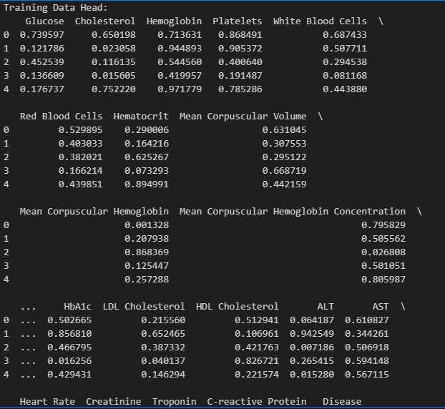
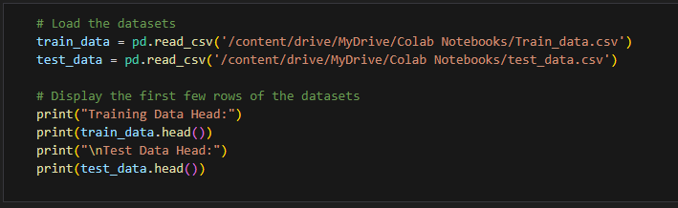
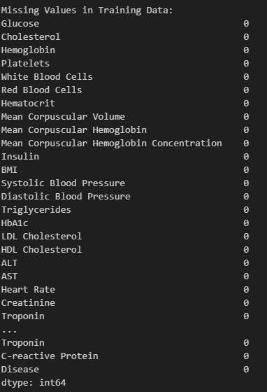
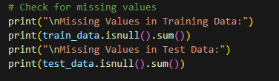
Load the Datasets
and Display Initial Data
Check for Missing Values

Slide 5
Data Transformation

Slide 6
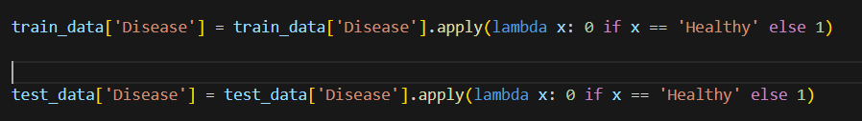
Convert Disease Labels to Binary
0: Healthy
1: Any disease

Slide 7
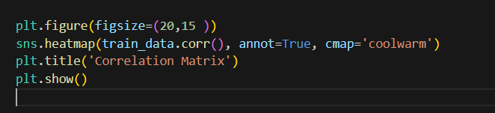
Exploratory Data Analysis (EDA)
Correlation Matrix

Slide 8
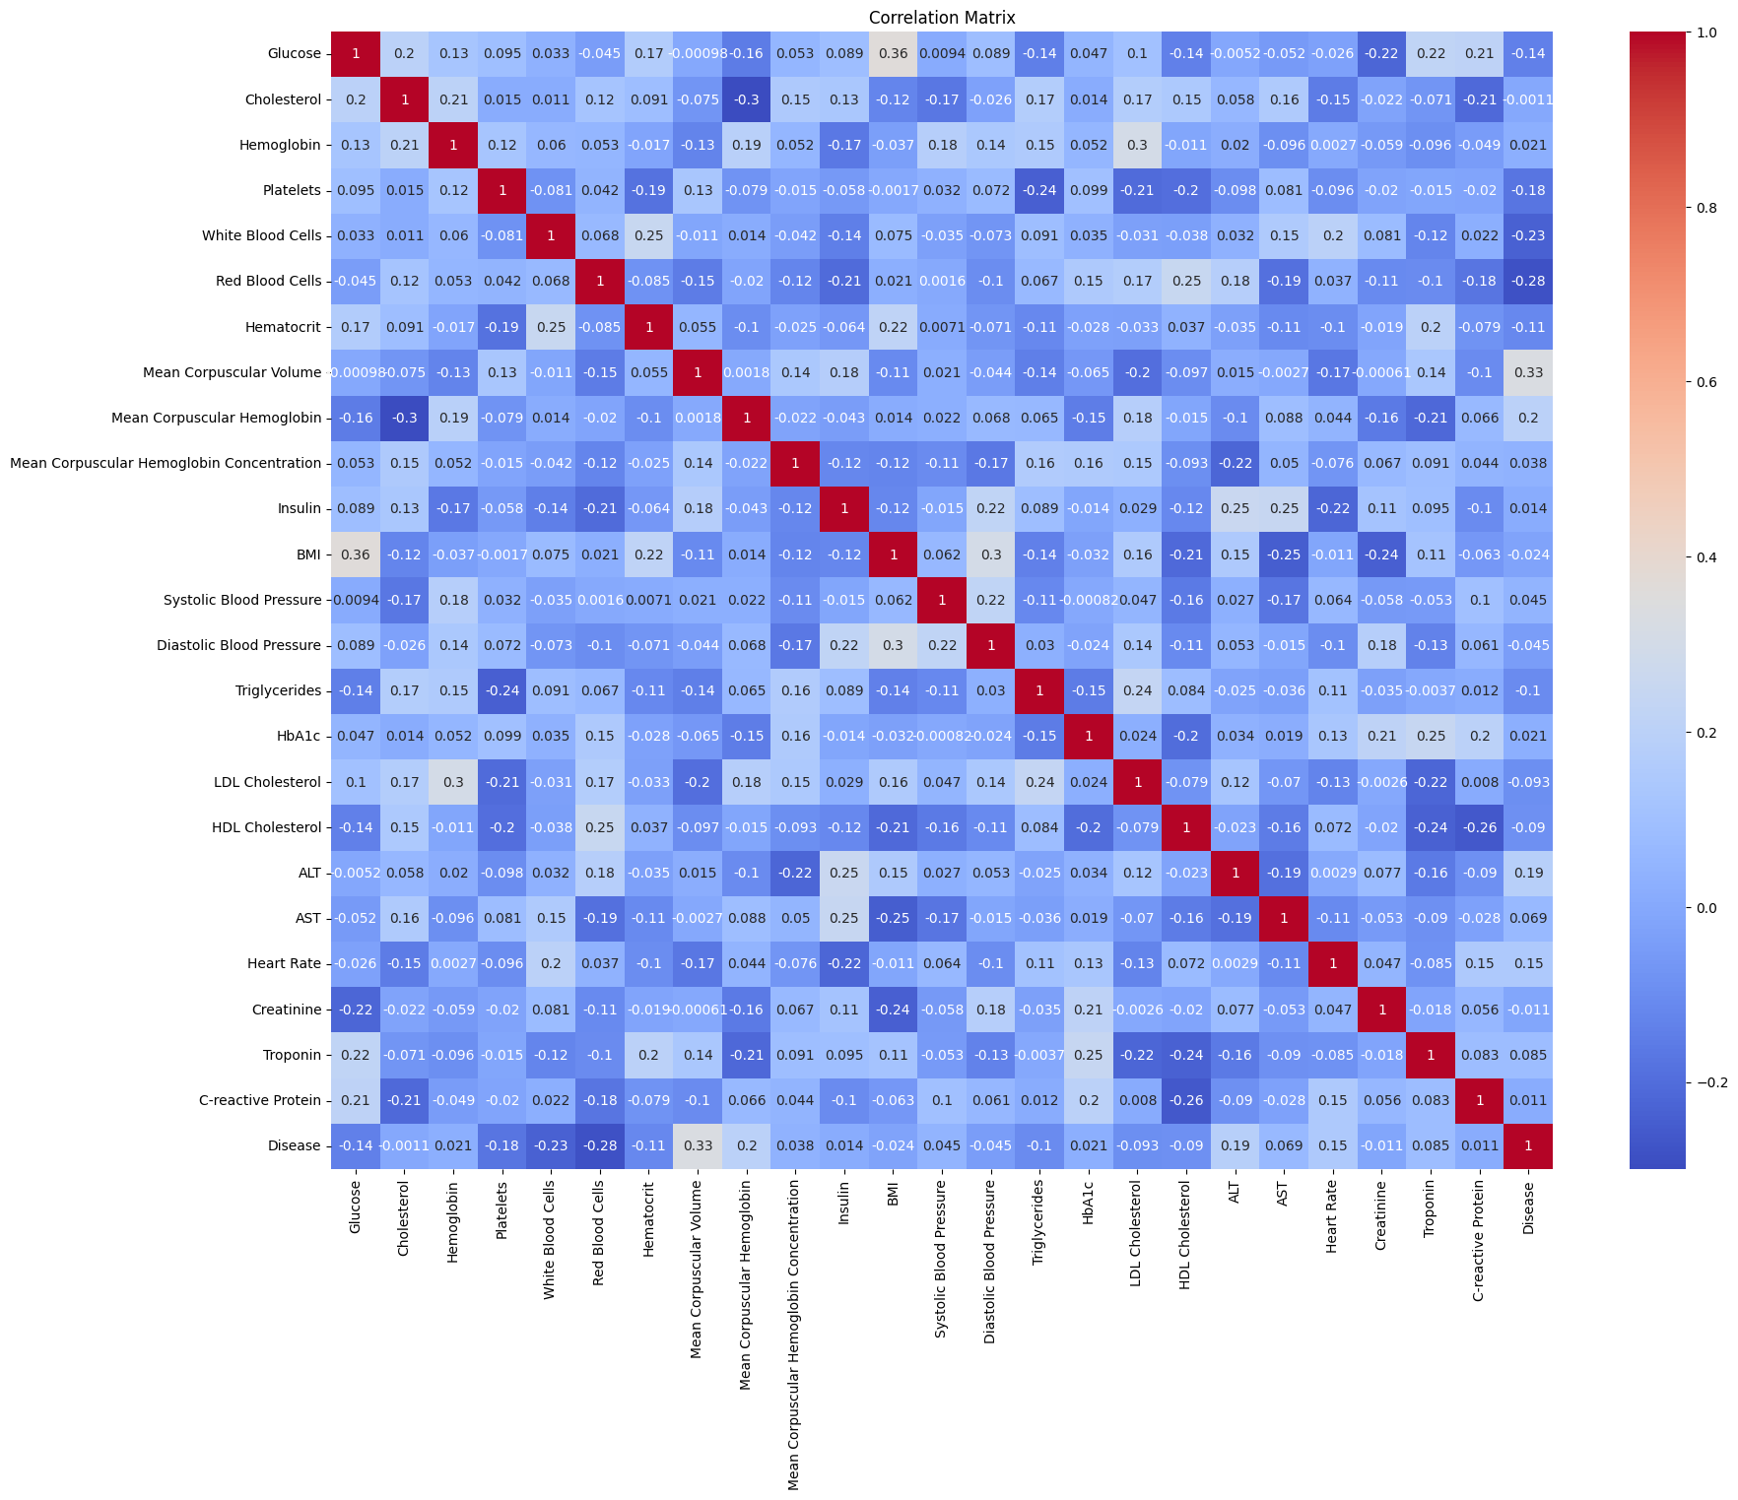

Slide 9
Feature Engineering
Add Interaction Terms
Cholesterol/HDL Ratio

Slide 10
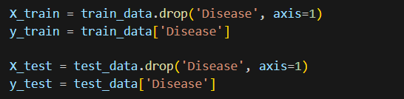

Model Training
Features and Target Split
Standardize Features
Train RandomForest Model

Slide 11

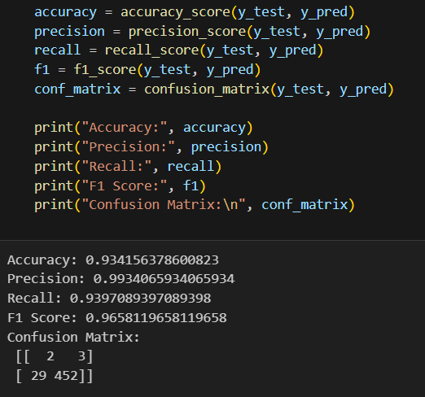
Model Evaluation
Predictions
Performance Metrics
Accuracy
Precision
Recall
F1 Score

Slide 12
Conclusion
The Random Forest model demonstrated good performance in predicting disease presence.
Further improvements can be achieved by exploring more advanced models and feature engineering techniques.

Slide 13
Thank you
Radwan Mohamed Amin Hefny
01203741440
radwanmoh1624@gmail.com

